Slide 1
Benjamin E. Mays High School
Notes:
Good Morning/Afternoon! Today we begin the process of planning our school’s budget for FY21. I know we are all here for the same reason and that is ensuring success for all (enter school name) students. This meeting is to provide an overview of the draft budget and for you to give feedback on the draft budget.

Slide 2
Norms
This is a meeting of the GO Team. Only members of the team may participate in the discussion. Any members of the public present are here to quietly observe.
We will follow the agenda as noticed to the public and stay on task.
We invite and welcome contributions of every member and listen to each other.
We will respect all ideas and assume good intentions.

Slide 3
GO Team Budget Development Process
YOUR SCHOOL STRATEGIC PLAN…
is your roadmap and your role. It is your direction, your priorities, your vision, your present, your future.
Step 1: Data Review
Step 2: Strategic Plan Review
Step 3: Budget Parameters
Step 4: Budget Choices
Notes:
Today I will provide an overview of the budget allocations for FY21. F WE WILL DECIDE ON OUR PRIORITIES AND THEN DISCUSS ALLOCATING FUNDS TO ADDRESS THOSE PRIORITIES).

Slide 4
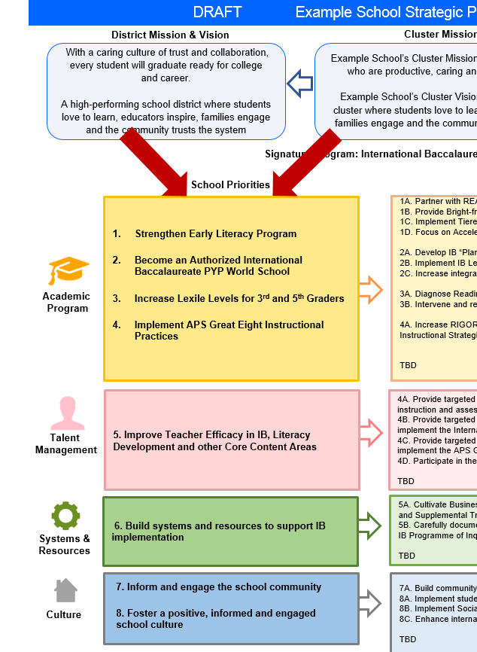
FY21 Budget Development Process
Principal’s Role
Design the budget and propose operational changes that can raise student achievement
Flesh out strategies, implement and manage them at the school level
Focus on the day-to-day operations
Serve as the expert on the school
Hire quality instructional and support personnel
The GO Team’s Role:
Focus on the big picture (positions and resources, not people)
Ensure that the budget is aligned to the school’s mission and vision and that resources are allocated to support key strategic priorities

Slide 5
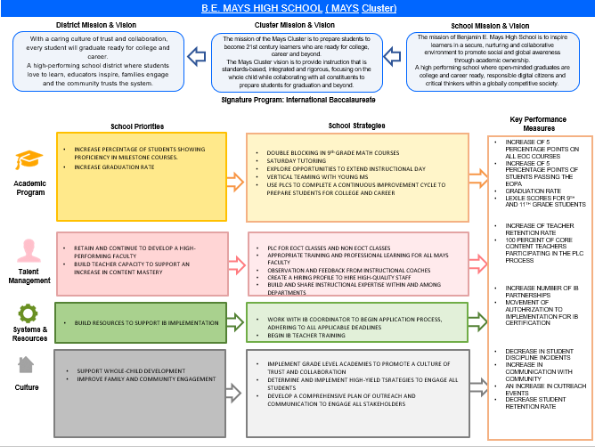
Benjamin E. Mays Strategic Plan
(Insert Copy of Approved Strategic Plan Here)
Notes:
You should have a copy of our updated strategic plan (please make copies to be distributed to team). Discuss priorities and rationale

Slide 6
Discussion of Budget Summary
(Step 4: Budget Choices)

Slide 7
Executive Summary
This budget represents an investment plan for our school’s students, employees and the community as a whole.
The budget recommendations are tied directly to the school’s strategic vision and direction.
The proposed budget for the general operations of the school are reflected at $__13,138, 092____
This investment plan for FY21 accommodates a student population that is projected to be __1201___ students, which is a decrease of __53____ students from FY20.
Notes:
Here’s a few highlights for our budget this year – read executive summary

Slide 8
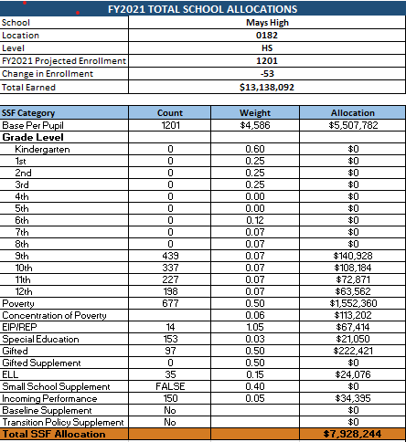
School Allocation
Notes:
For FY21, APS is continuing to increase equity within the District and the flexibility principals have in regards to our schools budgeted funds. The new Student Success Funding Model (SSF) allocates dollars to schools based on the number of enrolled students and receives a funding "weight" based on need. This year, student characteristics were weighted based on:
Grade Level –
K
1st through 3rd
6th
9th
Poverty – Weighted for all Direct Certification enrolled students.
Beginning Performance – Weighted Middle School and High School students entering with beginner’s performance on milestones.
ESOL – Weighted for all ESOL designated students in order to supplement due to ESOL staff being locked.
Special Education - Weighted for all Special Education students.
Gifted – Weighted and measured by number of students in the Gifted Program
Small School Supplement – Weighted for low enrollment schools
ES – 500
MS – 600
HS – 700
As you can see, our projected enrollment for FY19 is _______, we increased/decreased by __________ from last year.
We received the following weights for our student characteristics: (Below is just for the script, principals need to insert their school’s characteristics)
Grade Level
Poverty
Special Education
Gifted
Gifted Supplement
ELL
Small School Supplement

Slide 9
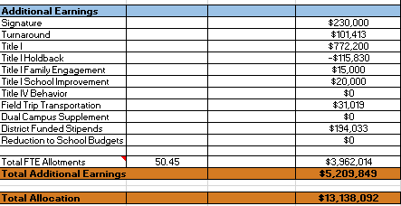
School Allocation
Notes:
Additionally, we received money for signature programming, turnaround, Title I and FTE Allotments.

Slide 10
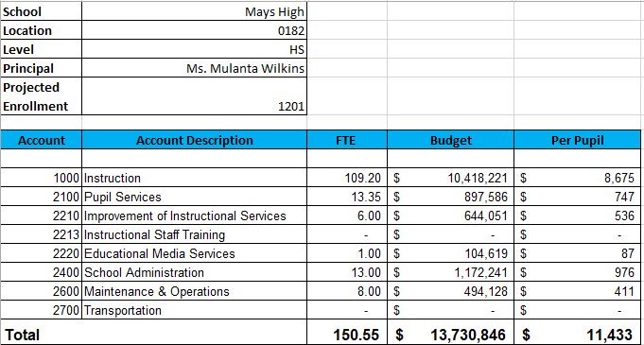
Budget by Function (Required)
Notes:
I am passing out the definitions for these funding categories. You will see what makes up each category. Although the total amount will not change, allocation per function may depending on our conversations and school needs.

Slide 11
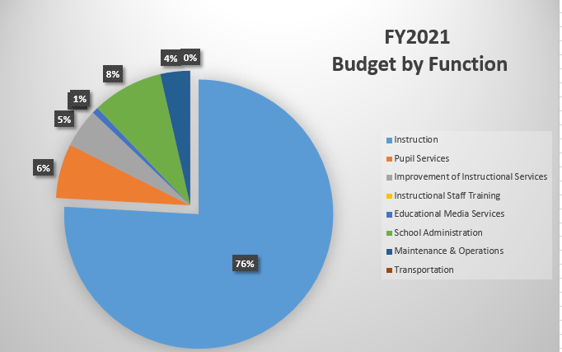
Budget by Function (Required)
Notes:
Explain the pie chart and allocations

Slide 12
What’s Next?
January:
GO Team Initial Budget Session (Jan. 21st-31st)
February:
One-on-one Associate Superintendent discussions
Cluster Planning Session (positions sharing, cluster alignment, etc.)
Program Manager discussions and approvals
GO Team Feedback Session
HR Staffing Conferences (February 24th - March 2nd)
• March:
Final GO Team Approval (March 3rd - March 13th)
Notes:
In February, we will meet again to discuss how the school’s budget has been allocated to support the programmatic needs and FY21 key strategic priorities.
If think we need to continue our budget conversations, we will schedule additional meetings. My goal is to make sure your voices are reflected in our school’s budget.
I will also be meeting with my Associate Superintendent, program managers and other key leaders to go over our budget and to make sure the school is meeting the standards of service and appropriately staffing.
During the week of Feb. 24th -March 2nd , HR Staffing Conferences will be held. At this meeting, I will present my plan for staff utilization, resource distribution and plan for staffing implications.
We will need to approve the budget at the ________ meeting.

Slide 13
Questions?
Thank you for your time and attention.
Notes:
IF YOU FEEL YOUR TEAM IS READY TO APPROVE THE DRAFT BUDGET, PLEASE DO SO. PLEASE REMIND THEM THAT YOU MAY NEED TO MEET WITH THEM AGAIN, IF THERE ARE CHANGES FROM YOUR MEETINGS WITH DISTRICT LEADERSHIP. LET THEM KNOW YOU WILL KEEP THEM INFORMED!!

